Slide 1
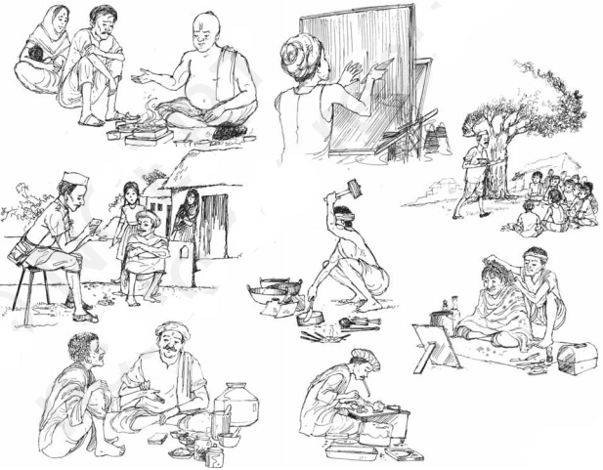
Agrarian Relations in British Bengal: The Role of Permanent Settlement System

Slide 2
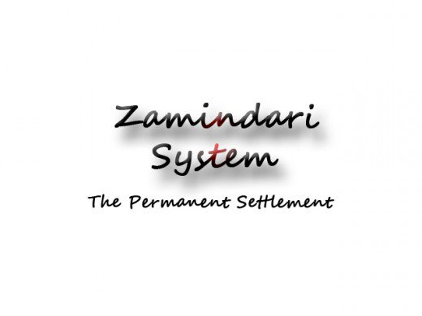

Slide 3
Key observation:
…fostered the accumulation of capital
“feudatory chiefs” vs. “landlord”
“Zamindar” vs. “jotedars,”
…led to a commercialisation of land
descendants, and to merchants and bankers".
…was a sort of aristocratic feudalism

Slide 4
…led to a change in the social background of the ruling class from "lineages and local chiefs" to "under civil servants and their
Zamindars….. “permanent masters of their lands”.…

Slide 5
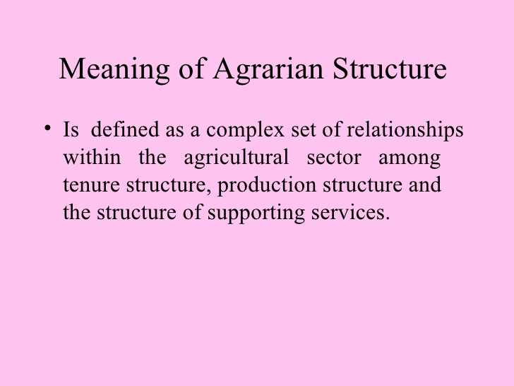

Slide 6
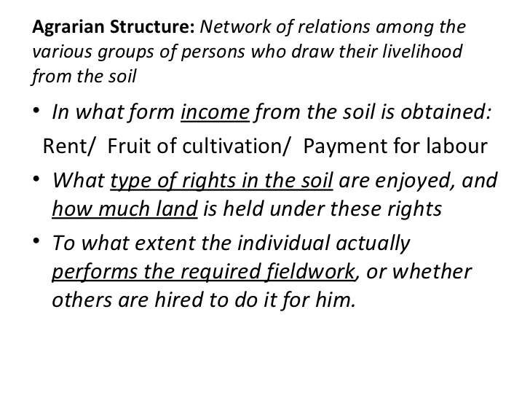

Slide 7
The British East India Company was the pioneer of three major land settlements in India in various regions on the basis of contemporary circumstances and colonial requirements…

Slide 8
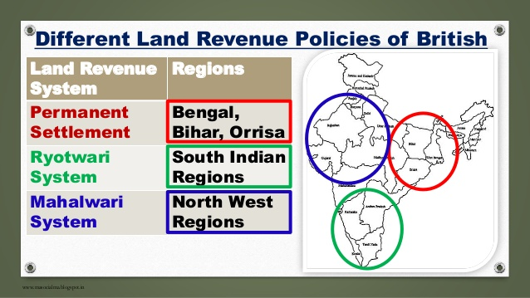

Slide 9
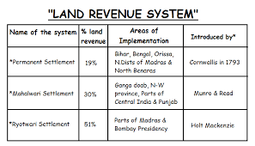

Slide 10
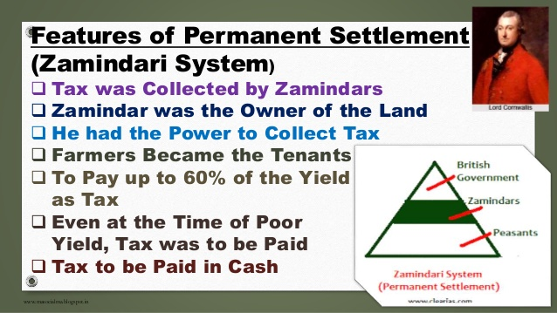

Slide 11
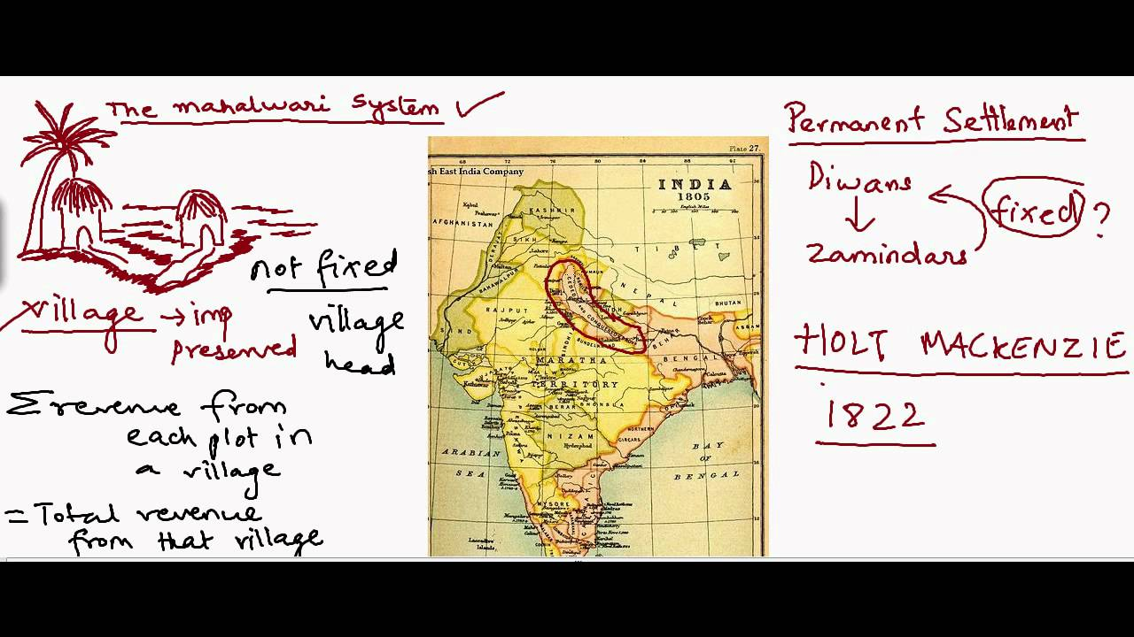

Slide 12
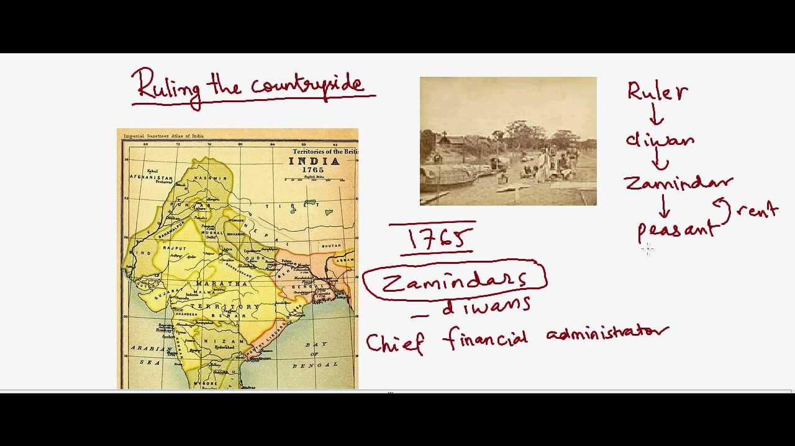

Slide 13
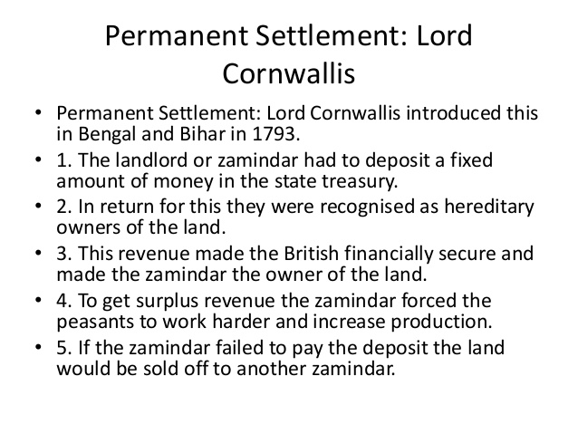

Slide 14
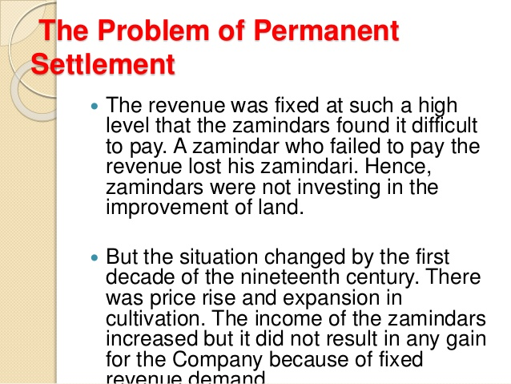

Slide 15
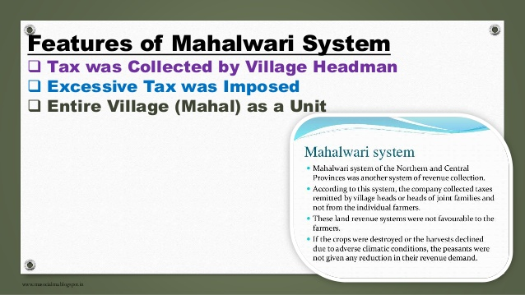

Slide 16
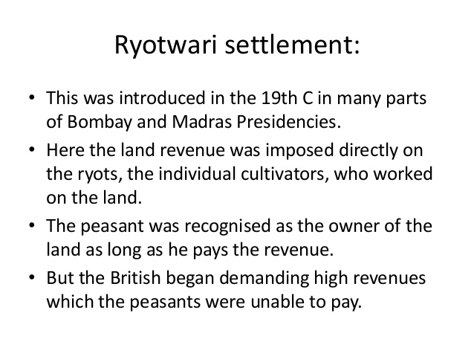

Slide 17
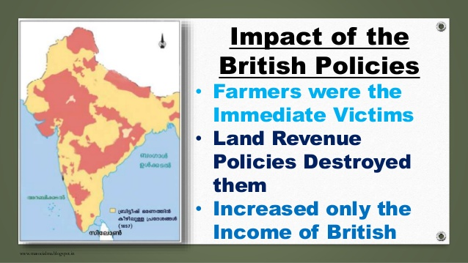

Slide 18
Basically these were the modern way of extracting maximum revenues from the peasants and, an absolute plan to plunder Indian resources constantly.
The land tax was the major source of revenue for the British Government; amounting in 1858-59, to Rs 18.12 corers or 50.3 percent of total its revenues.

Slide 19
Mughul Land Tenure System
Tenants have no land ownership during Moghul period
Moghul Raj collected land tax through village Mattabors in India who had contact communications with Moghl Raj
During that period, there was no Jamidari inheritance in India
There was no elite class based on land tenure system in Moghul period

Slide 20
The Moghul Raj had no control over Hindhu Kings if Hindho kings regularly provided annual tax to Moghul Raj
The Hindo Raj controlled some areas of India independently if they given annul tax to Moghul Raj
The Hindo Kings collect land tax from their agents and pay tax to central Moghul Raj treasurer

Slide 21
The second system of land tax collect was Moghul Raj officers directly collect land tax from Krishok without village Mattabbors
There was no private land ownership or no direct control over land by Moghul Raj or
No Jamidar class developed based on land occupation
Real land occupied persons were those people who were cultivating lands during Moghul Raj
Those called Zamindars during that period who was agents of land tax collectors
However, they were not the owner of lands or landlords.

Slide 22
East India Dawani Prapti and Consequence in Bengal Society
East India Company got Bengal land tax collection attorney from Moghul Raj in 1765
In a memorandum, it was mentioned Raiyats shall not increase by British company
Rather East India Company protects Raiyats from exploitations and injustice
British East India Company exploited Krishok much more than it was during in Moghul Raj
The East India Company was a commercial institution; its aim was to make profit

Slide 23
There was much mismanagement, indiscipline in East India Company management
The company robbed Krishoks resources and the Krishoks suffered
Krishoks suffered from famine and other miseries-even the historic 76’s Famine happened in Bangla when one third Krishoks died of it
Although British claims natural disasters and droughts were responsible for famine, but it was not correct

Slide 24
The British agents collected rice and other crops through business people who made huge profit out of it
For example, a man of Nabab family become a rich merchant in Murshidabad by involving in buying rice who was capital less
That business man made 60,000 pounds during famine time
He sent this money to Europe after Famine
The land tax was TK.1, 52, 04,856 before Famine in 1768, but after famine it was increased Tk.1, 57, 26,576 in 1771

Slide 25
The tax increased although one third people died in famine in Bengal.
The land tenure system was not developed although land tax increased
Lord Kornowalish observed Indian land tax collection and think for new land tenure system
He passes the Act Permanent Land Tenure System in 1793. This Act is called Permanent Settlement Act.

Slide 26
Permanent Settlement Act
Before permanent Settlement Acts, Zaminders were the agents of land collectors of the Raj and for the company
They have no land occupying rights
However, after Permanent Settlement Act, Zamindars got land occupying rights and
They were the owner of lands

Slide 27
Previously they are the agent of land collector for the Raj
Zaminders got rights to collect land tax from Krishok (Praja, tenants)
Under Settlement Act, 90% of the land tax need send to Company
If a Zamindar deposited certain amount of land tax money to company treasurer, he could get inheritance of Zamindari of lands of certain area lands

Slide 28
The land value and tax amount will not increased and their position will not change if they support British and maintain a good relation with is them
This settlement is unchangeable and permanent.
Previously the person was a legal land cultivating Krishok
Now (British) Krishok is a tax giver to land tax collector Zamindars
The land owning Zaminders become owners of lands and they sell and buy lands

Slide 29
Zamindars could distribute lands to people to whom they like
Under permanent land tenure system, Zaminders become owners of many forest, jungles, and water wetlands
This permanent settlement acts provide opportunity to Zaminders not only to be owners of lands
This system given them rights to make profits from lands

Slide 30
Under this permanent settlement act, the Bengal East India Company got land tax amounted two core sixty eight lack taka (3.6 million pounds)
The aim of East India Company is to rule India successful by creating their agents (Zaminders) in India.
Zamindars support British to rule India and exploit the resources of India
To robbed the resources and unjust to people
The British Raj developed the friendship power (Mitra Shakti)
This company carried political goal
Continue their imperialistic rule in India by the help of Zaminders through Permanent Settlement Acts
Zaminders served the British Raj with Trust.

Slide 31
Post-Permanent Settlement Acts:
A powerful Zaminder elite class emerged in India who were unjust to peasants
Zaminders lived in town and collect tax through their Nayeb, Gomosta
They misused that money by expensing luxurious life
They don’t spend money for land development or for peasants’ life improvement
Zaminders imposed new taxes and collect those land taxes by force

Slide 32
Peasants become poor and poor to repay land taxes and become landless and asset less
British government do not care for peasants
Peasants revolt at different places and conflict with Zaminders
However, British government sends police and punished, arrest, toured even killed peasants
All land taxes were pocketed in Zaminders pockets

Slide 33
Government and peasants none were benefited from land tax revenues in nineteenth and twentieth century
In 1880, Zaminders collected two corers pounds land tax from peasants
Only forty lacks pounds deposited to state treasurer
After permanent settlement act, a powerful Zaminder elite class emerged in India who were unjust to peasants
The intermediate group land tax collectors given responsibility them by Zaminders

Slide 34
Different Elites created in Bengal Peasant Society
Intermediate land tax collecting elites created for supporting hands of Zaminders
New Zaminders are Mussuddi, Bania, Muhajon and merchants
Petty merchants (Furia) generated through land leasing new system and developed a new land leasing system in India
Among new Zaminders, maximum were absentee Zaminder, Bania, brokers and merchants lived in city
They were unable to collect land taxes regularly as they living in town
British government accepted these new petty Zaminder elites and tolerates their exploitations to peasants
As a result these new land tax collectors, land lords made money, build houses in town and spend a luxurious life at the cost peasant face

Slide 35
Land Tax Zaminars and their Negative side
The intermediate land tax collectors collect additional taxes from peasants for their own benefit
Intermediate elite groups, peasants, collect extra crops for their own consumption
These unjust exploitations and tortured increased rapidly resulted food scarcity
Spread epidemic diseases, defaulter peasants evicted from their cultivated lands
Even today many Zamindars are living in luxurious life in Dhaka
They occupied huge lands, resources and misuse these resources for their own luxurious life
Many of their families send money to outside countries
Their children, family members live in Western countries with these resources
Many peasants are now suffering from poverty, malnutrition and starvation.

Slide 36
Historian Bernard S. Cohn and others have argued that the Permanent Settlement led to a commercialisation of land, which previously did not exist in Bengal and, as a consequence, it led to a change in the social background of the ruling class from "lineages and local chiefs" to "under civil servants and their descendants, and to merchants and bankers".

Slide 37
M.R. Tarafdar has rightly pointed out that the Permanent Settlement of 1793 was a sort of aristocratic feudalism

Slide 38
Zamindars….. “permanent masters of their lands”.…

Slide 39
The permanent settlement by creating a rich and leisured class has fostered the accumulation of capital, and large industries may be rendered possible in eastern India by the financial banking of Zamindars, and acts as a body of middleman between the state and cultivator, who have identified themselves with British rule, and have always given loyal help in the cause of good administration.

Slide 40
The zamindars were a diverse group. Some who had enormous estates, military capacity, and judicial and administrative responsibilities might well be called (Bose 1993, p. 70) “feudatory chiefs.” Others operated on a much smaller scale and might fit the more conventional definition of “landlord.”

Slide 41
The zamindars were, however, only the first tier in the agrarian hierarchy. The land on which they collected taxes might well be in the hands of “jotedars,” who had secure occupancy rights to their land, at customary rents (Sinha 1962, p. 18, p. 27). Jotedars could be quite powerful at the village level, and might have tenants of their own (Ray 1979, pp. 6- 7).
In short, the agrarian hierarchy was complex, with several possible intermediaries between the zamindar and the actual tiller of the soil.

Slide 42
